Slide 1
UI DEBUGGING
https://github.com/tnt-summer-academy/Curriculum-2022/wiki/%5BENG3.1%5D-UI-debugging
Created for Microsoft / TNTs

Slide 2
Learning objectives
TNTs will learn basic UI debugging with the browser developers tools
TNTs will understand how to investigate HTML/CSS changes while debugging
TNTs will explore the browser debugging tools

Slide 3
PART 0 INSTALL THE TOOLS
5 minutes

Slide 4
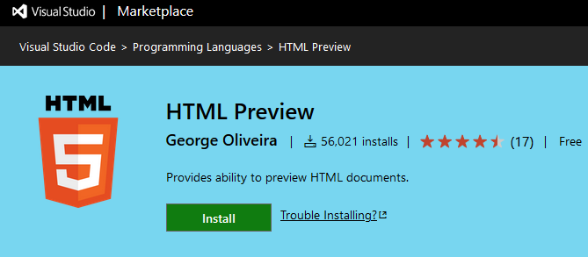
VS Code HTML Preview Extension
VS Code HTML Preview Extension
https://marketplace.visualstudio.com/items?itemName=george-alisson.html-preview-vscode

Slide 5
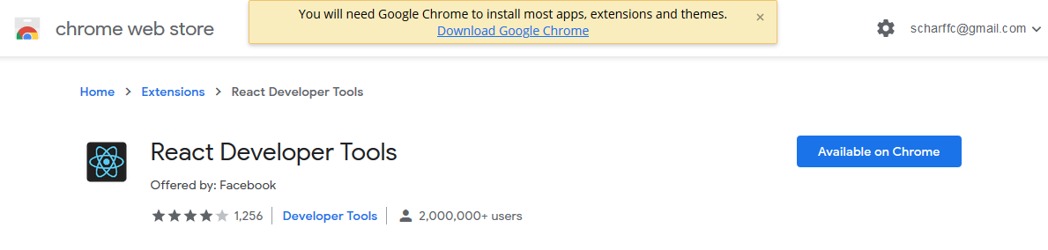
React Developer Tools
https://chrome.google.com/webstore/detail/react-developer-tools

Slide 6
PART 1 CHROME DEBUGGER OVERVIEW
5 minutes

Slide 7
Elements panel - View and modify the DOM and CSS that is loaded in the browser memory
Console panel - View messages, errors warnings and info, and run JS commands
Sources panel - Debug Javascript files via breakpoints, view other source files
Network panel - View network traffic, HTTP status codes, file types, file size, download times, etc.
Performance - View performance metrics by recording a page interaction

Slide 8
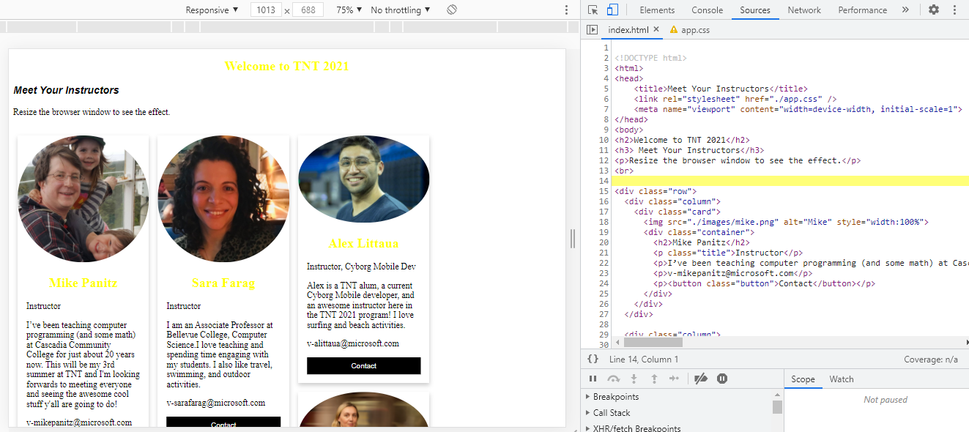
Source code

Slide 9
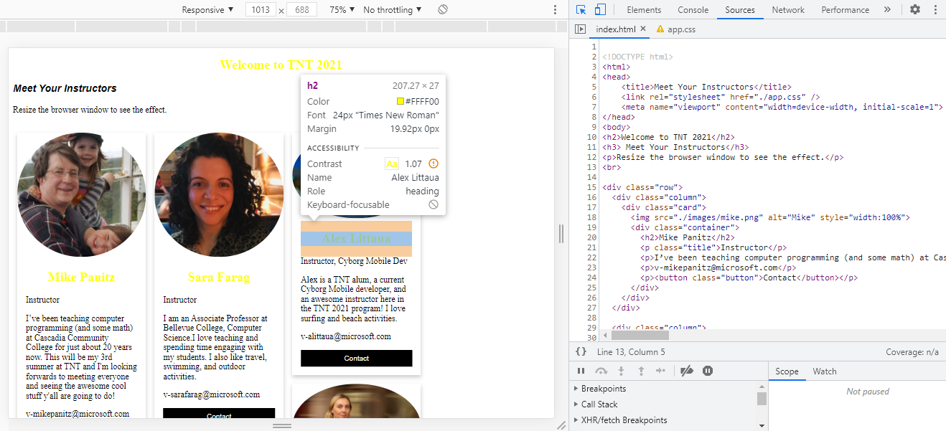
Inspect element

Slide 10
PART 2 CSS DEBUGGING
5 minutes

Slide 11
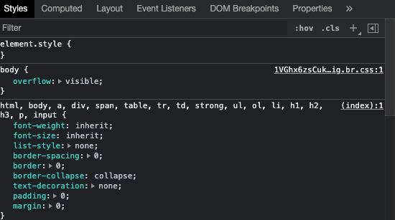

Slide 12
PART 3 LOOK AT THE COMPONENTS
5 minutes

Slide 13
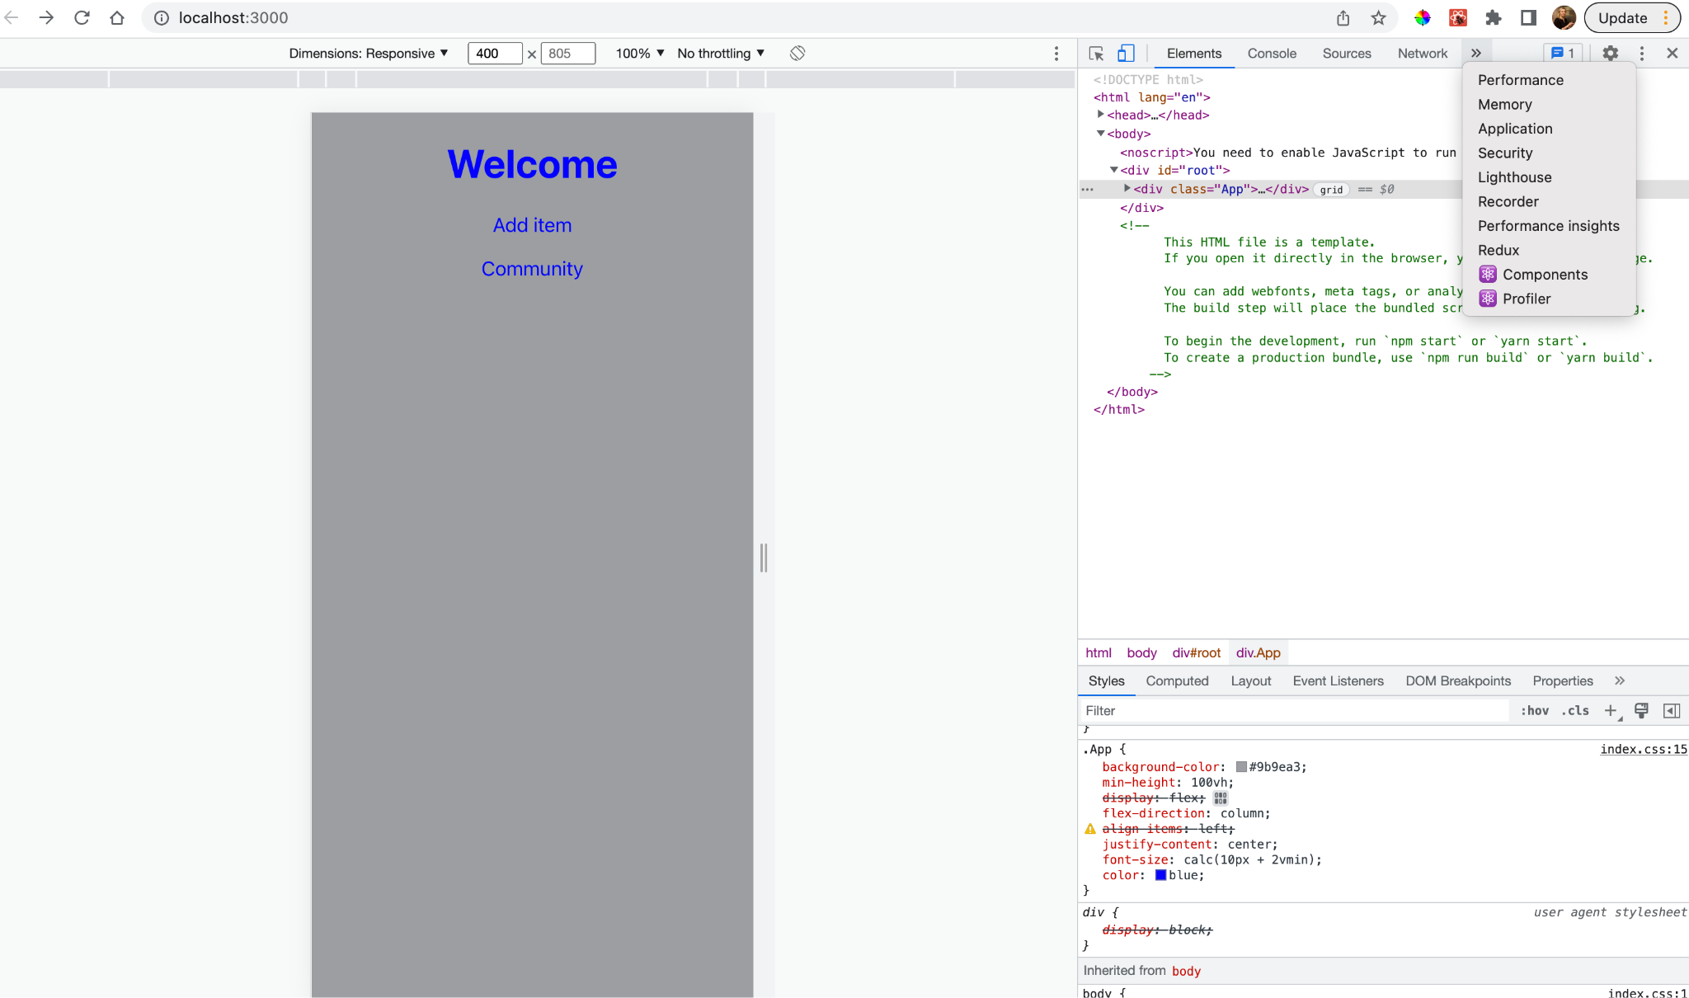

Slide 14
PART 3 DEBUG in VS CODE
Seen before

